Slide 1
DATA SCIENCE
PROJECT
Retail Data Analytics
Notes:
I found a dataset on kaggle that provided me with anonymous retail data for 45 different stores of a particular company.

Slide 2
TABLE OF CONTENTS
01
02
03
PROBLEM
METHODOLOGY & INSIGHTS
RECOMMENDATIONS & FUTURE

Slide 3
Company Problem
With rising competition in the retail industry, a company that elected to remain anonymous is pressured to analyze their overall company performance. The company also wants to look into their top store’s performance and analyze trends that affect sales to capture important insights.
Notes:
Just like any retail company, there is a lot of competition. A decrease in sales could be from a number of factors and represent a concern for the business. In a retail setting, I thought about how to best provide executives with insights about how their stores are performing. I also wanted to try to dig into the data and figure out a few key factors that might lead to an increase or decrease in sales.

Slide 4
Methodology
Getting insights & Making Recommendations
Querying & Visualizing
Data Preparation
Split Data
& Use ML Models
Read in Dataframes, Merged Tables, Cleaned and converted data
Get Train, and Test data, define, fit, and check models for accuracy
Queried and aggregated data to perform top level visualizations
Use models to predict store sales, see what seems to affect sale performance

Slide 5
Methodology
Time
Department
Store
Key Performance Drivers
At what times did the company have highest and lowest sales?
What departments are most profitable?
Which store is most profitable?
What are some key drivers and predictions of sales?

Slide 6
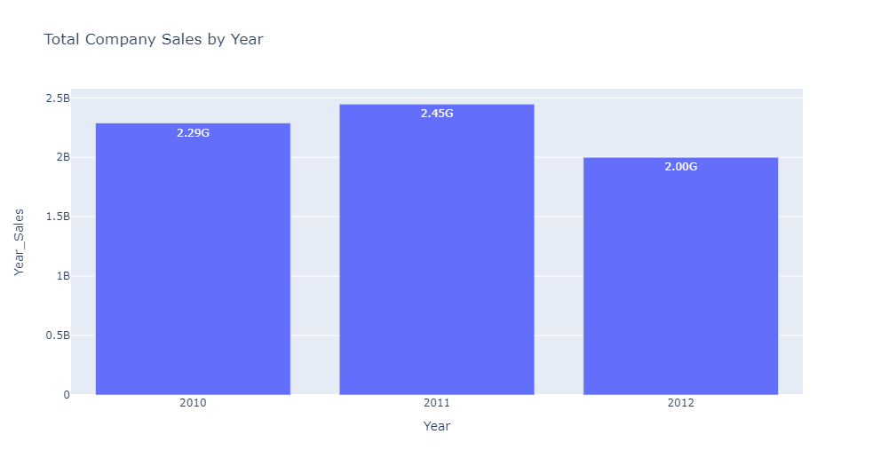
Findings/Insights
Notes:
So my data had 3 years, 2010, 2011 and 2012 and we’re going to pretend like this is more recent data for the sake of a real life scenario. In 2011, the company did the best at 2.4 billion dollars, but saw a sharp drop in sales in 2012 with 2 billion dollars.

Slide 7
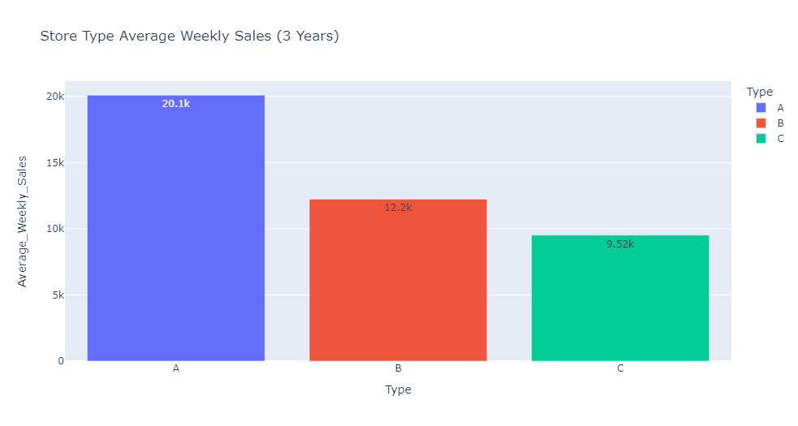
Findings/Insights
Notes:
This visualization show the average weekly sales based on store type over the 3 year period. From this visualization we can see that Store Type A’s perform the best on a weekly basis.

Slide 8
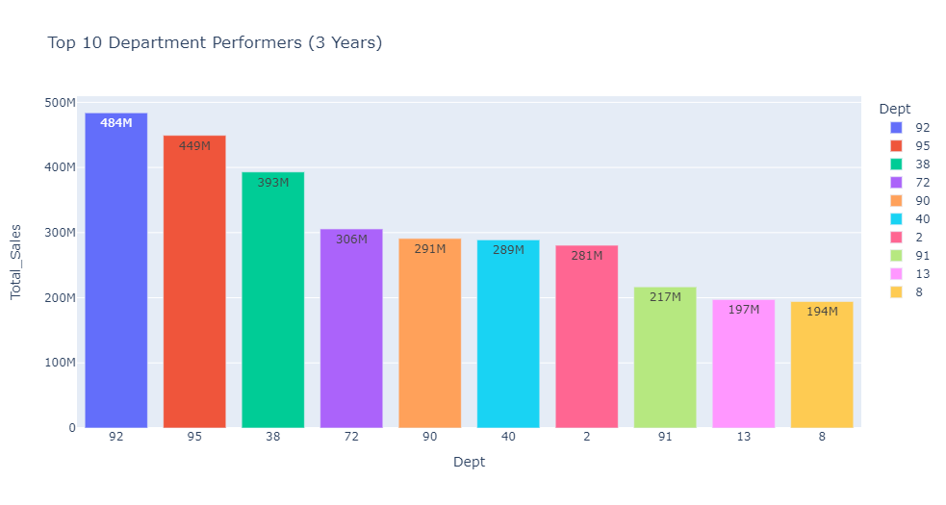
Findings/Insights
Notes:
This visualization lays out our top 10 performing departments over a 3 year period. We can see that department 92, 95 and 38 are performing the best, so it would probably be beneficial to look further into those departments.

Slide 9
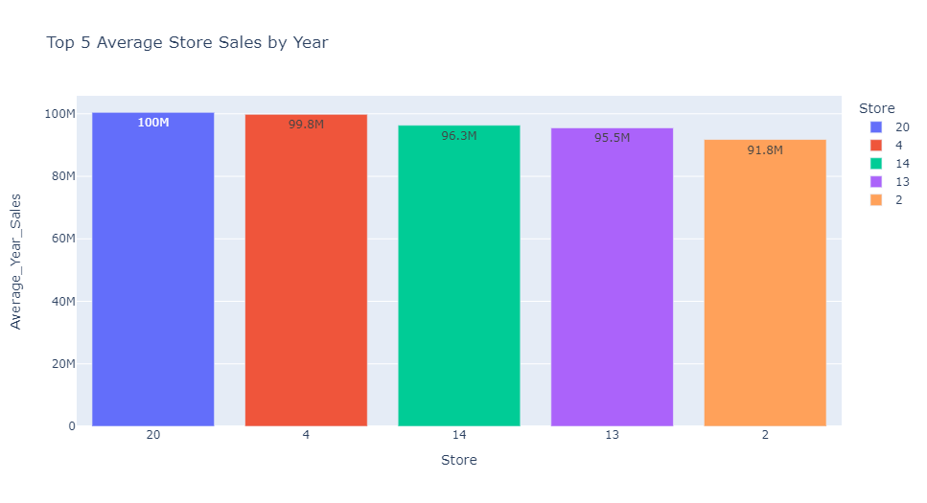
Findings/Insights
Notes:
Now we see our top performing stores on average over the 3 year period. Store 20 does consistently well, and it would be beneficial to look into what they’re doing right and get more insights.

Slide 10
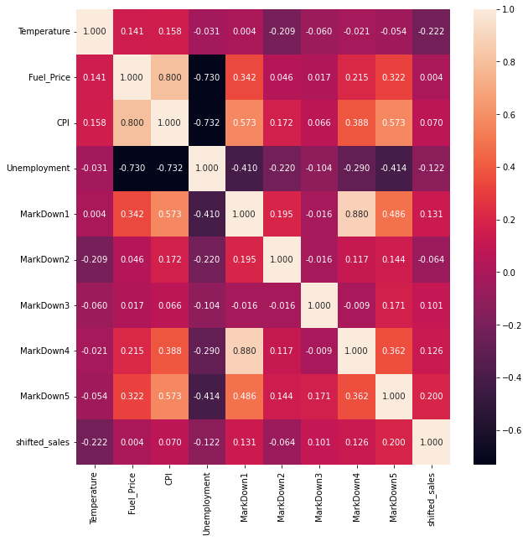
Store #20
Correlation
Heatmap
Notes:
I also did a correlation heatmap on the top performing store. It was interesting to see that markdown category 1 was highly correlated with markdown category 4. As far as external factors, customer price index (CPI) seems to be highly correlated to fuel price.
Definition for reference:
The Consumer Price Index measures the overall change in consumer prices based on a representative basket of goods and services over time.

Slide 11
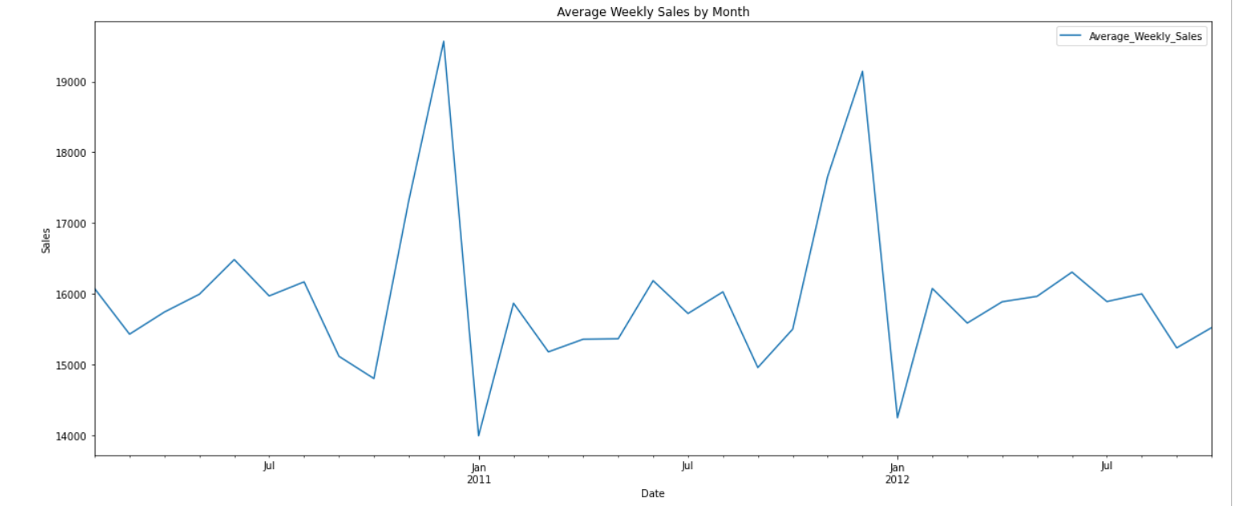
Findings/Insights
Notes:
Here we can see the average weekly company sales on a month by month basis. Company peak sales performance seems to be around the months of November and December.

Slide 12
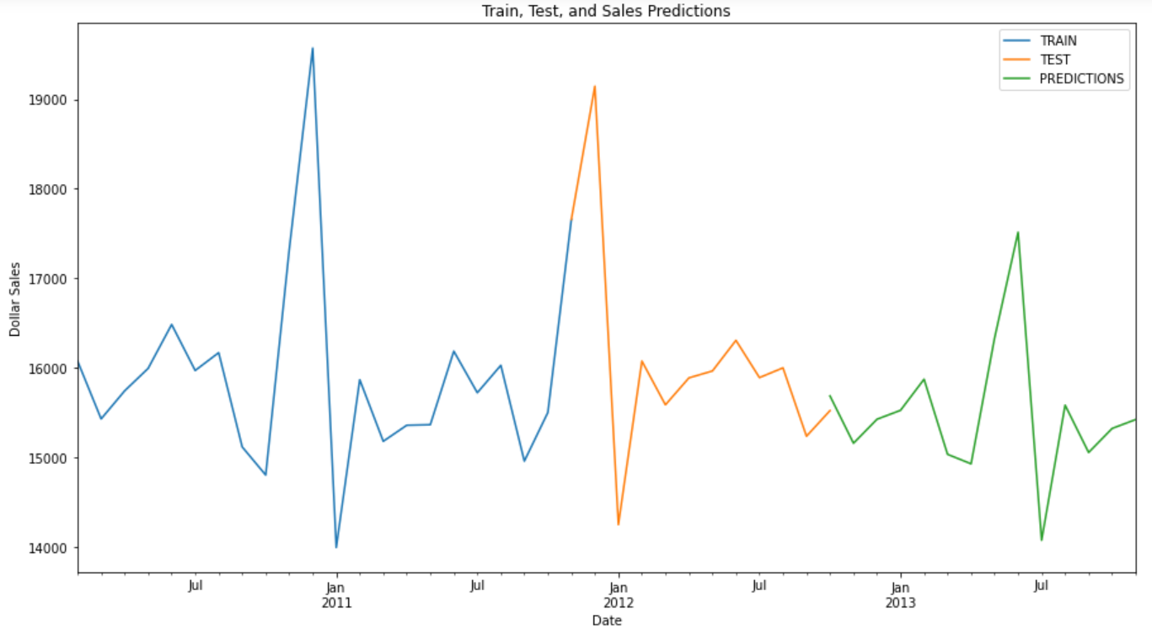
Predictions
Notes:
I used an Exponential Smoothing Model to try and predict sales for a year ahead. Based off of this chart, we can see that there seems to be a downward trend in the average weekly sales.

Slide 13
Recommendations
Replicate more Type A Store Layouts
Focus advertising and marketing in the top store departments 92, 95, and 38
Look into top store performers to train other stores on similar methods, techniques, and strategies for success
Notes:
Since the prediction model shows a downwards trend in sales, I recommend to replicate more Type A store Layouts, Focus advertising and marketing in store departments 92, 95, and 38, and finally look further into the company’s top store performers and use those stores’ methods, techniques and strategies as an example for other stores to become more successful.

Slide 14
Future Work
Look into how markdowns affect the weekly sales and what markdown categories seem to boost sales the most
Look into other external factors and come up with a strategic plan
Notes:
Finally for future work, we want to look into how markdowns affect the weekly sales and what markdown categories seem to boost sales the most. We then want to look into other external factors in the data and try to come up with strategies to use those factors to the company’s benefit.

